Slide 1

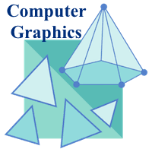
Lecture 1
Introduction to Computer Graphics
Prepared by Tapasy Rabeya Senior Lecturer CSE, DIU | Course Teacher Nushrat Jahan Oyshi Lecturer CSE, DIU
Department of CSE, Daffodil International University
Notes:
‹#›

Slide 2
Graphics Systems and Models
Computer Graphics is the use of computers to display and manipulate information in graphical or pictorial form, either on a visual-display unit or via a printer or plotter.

Slide 3
Applications of Computer Graphics
COMPUTER AIDED DESIGN
Animations are often used in CAD applications.
Real-time animations using wire frame displays are useful for testing performance of a vehicle.
Wire frame models allow the designer to see the interior parts of the vehicle during motion.
When object designs are complete, realistic lighting models and surface rendering are applied.
Manufacturing process of object can also be controlled through CAD.
Interactive graphics methods are used to layout the buildings.
Three-dimensional interior layouts and lighting also provided.
With virtual-reality systems, the designers can go for a simulated walk inside the building.
Example: AutoCAD, SolidWorks

Slide 4
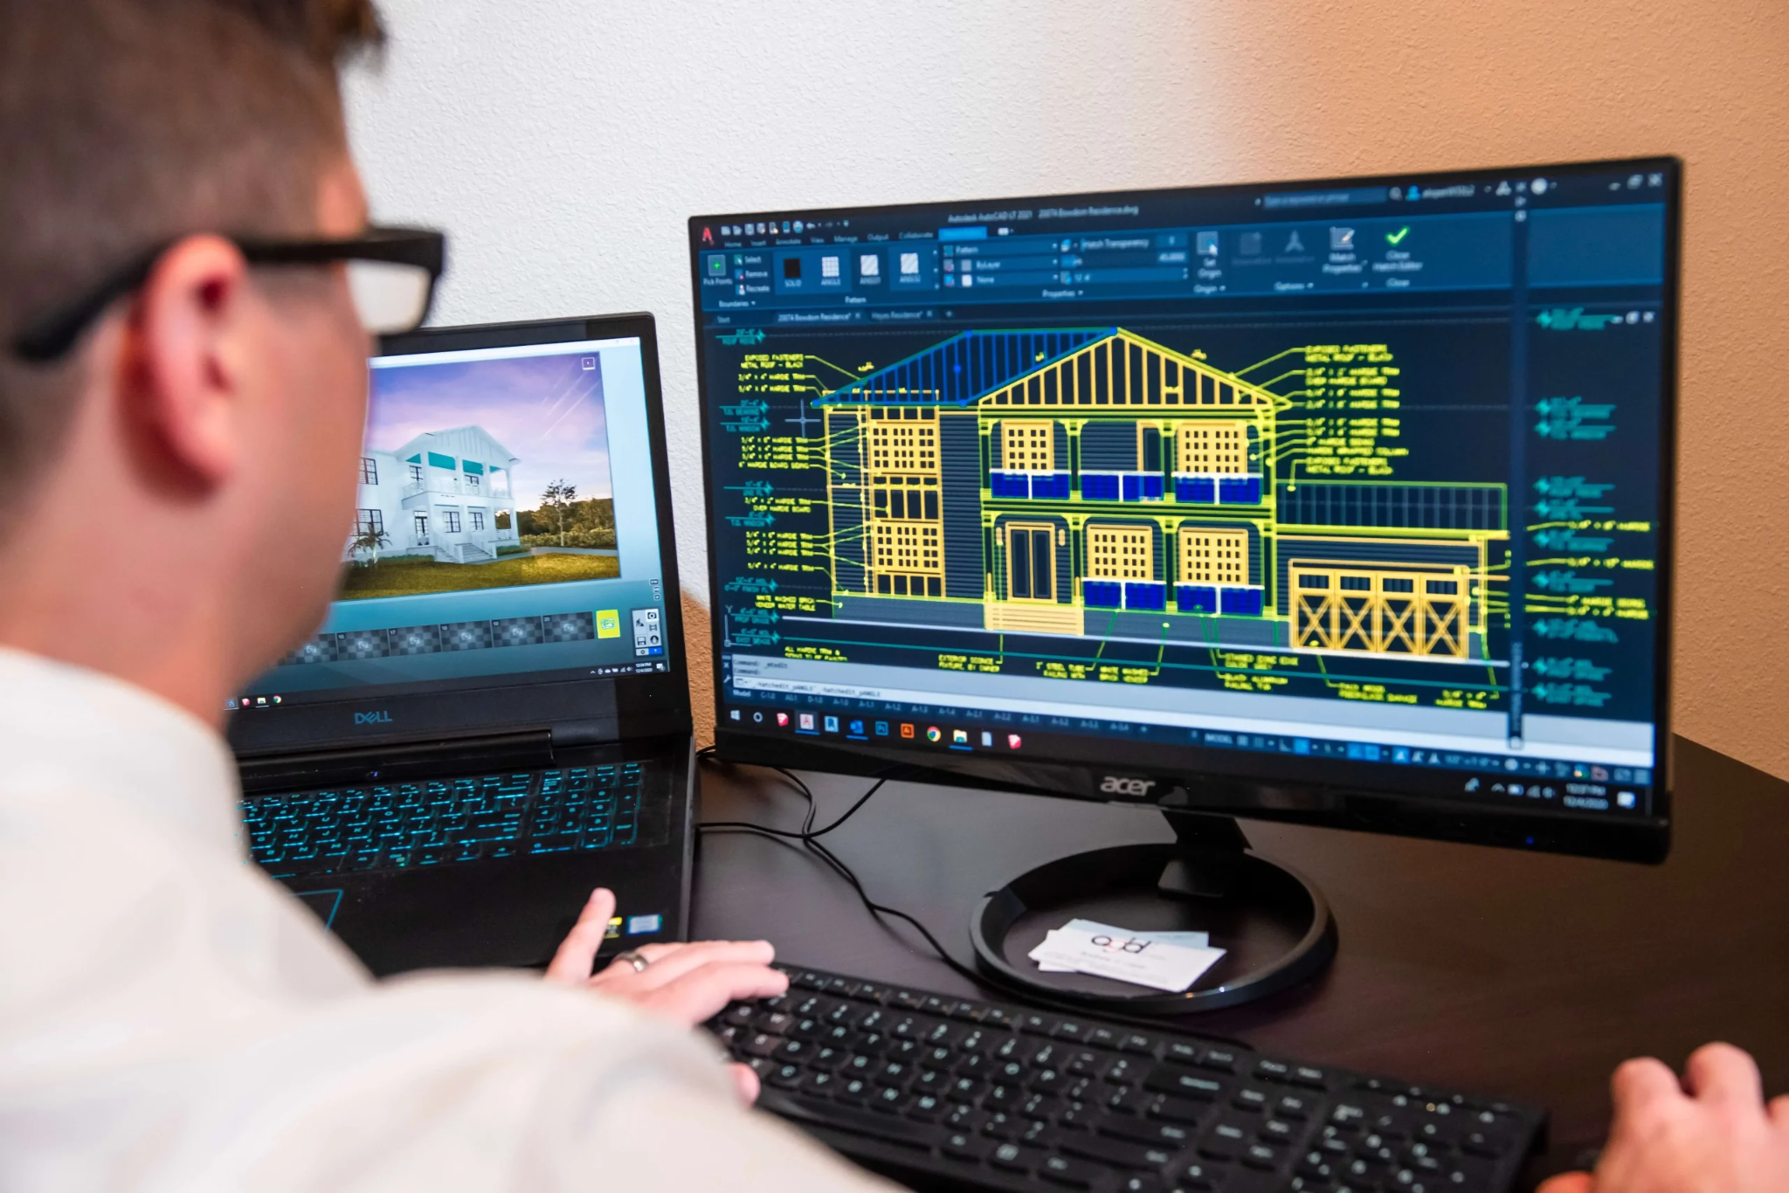
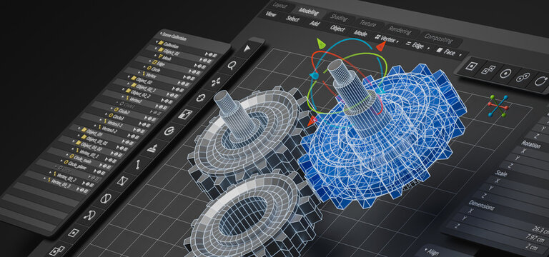
Applications of Computer Graphics

Slide 5
Applications of Computer Graphics
PRESENTATION GRAPHICS
It is used to produce illustrations for reports or to generate slide with projections.
Examples of presentation graphics are bar charts, line graphs, surface graphs, pie charts and displays showing relationships between parameters.
3D graphics can provide more attraction to the presentation.
Example: Microsoft PowerPoint, Microsoft Excel

Slide 6

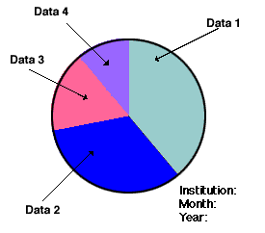
Applications of Computer Graphics

Slide 7
Applications of Computer Graphics
COMPUTER ART
Computer graphics methods are widely used in both fine art and commercial art applications.
The artist uses a combination of 3D modeling packages, texture mapping, drawing programs and CAD software.
“Mathematical Art” can be produced using mathematical functions, fractal procedures.
Photorealistic techniques are used to render images of a product.
Animations are also used frequently in advertising and television commercials which are produced frame by frame.
Example: Adobe Photoshop, Blender

Slide 8
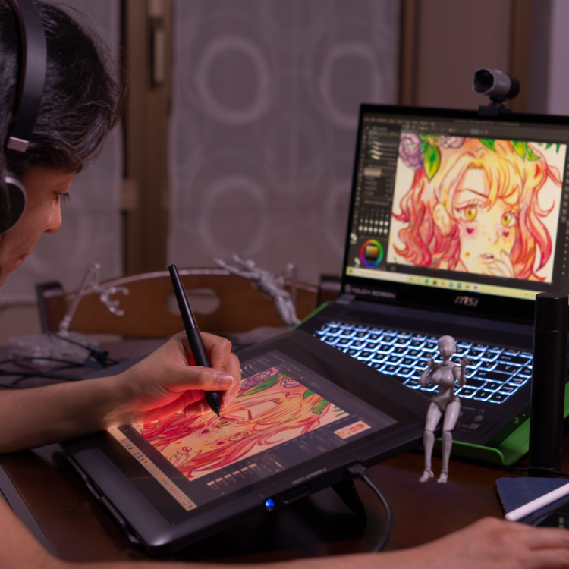
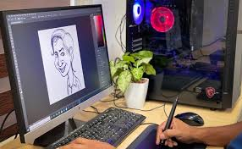
Applications of Computer Graphics

Slide 9
Applications of Computer Graphics
ENTERTAINMENT
CG methods are now commonly used in making motion pictures, music videos and television shows.
Many TV series regularly employ computer graphics method.
Graphics objects can be combined with a live action.
Example:Pixar, Avatar
Computer-Generated Imagery (CGI) is the application of computer graphics to create or improve still and moving images in art, films, television programs, commercials, and video games. It primarily refers to 3D computer graphics used to design characters, virtual environments, and special effects.
Example: Visual Effects (VFX), CGI Animation

Slide 10
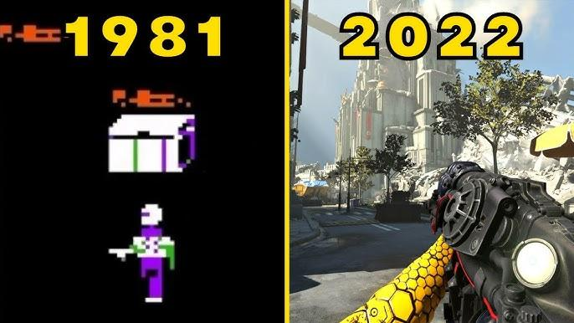
Applications of Computer Graphics

Slide 11
Applications of Computer Graphics
EDUCATION AND TRAINING
Computer-generated models of physical, financial and economic systems are often used as educational aids.
For some training applications, special systems are designed. Eg. Training of ship captains, aircraft pilots etc.,
Some simulators have no video screens, but most simulators provide graphics screen for visual operation.
Example: Flight simulators for pilot training, Virtual labs in
universities

Slide 12
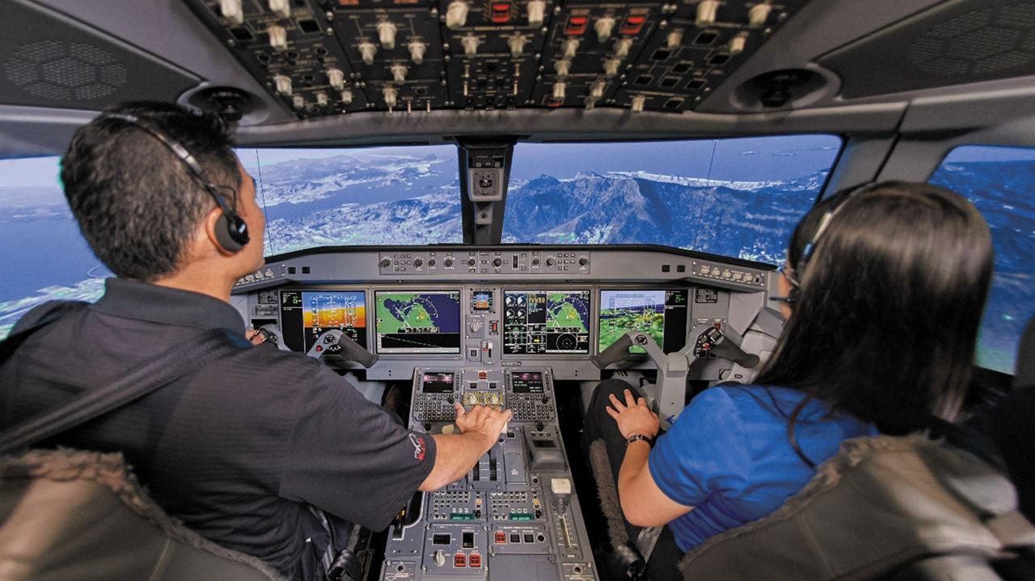
Applications of Computer Graphics

Slide 13
Applications of Computer Graphics
VISUALIZATION
The numerical and scientific data are converted to a visual form for analysis and to study the behavior called visualization.
Producing graphical representation for scientific data sets are calls scientific visualization.
And business visualization is used to represent the data sets related to commerce and industry.
The visualization can be either 2D or 3D.
Example: COVID-19 dashboards, Weather forecasting systems

Slide 14
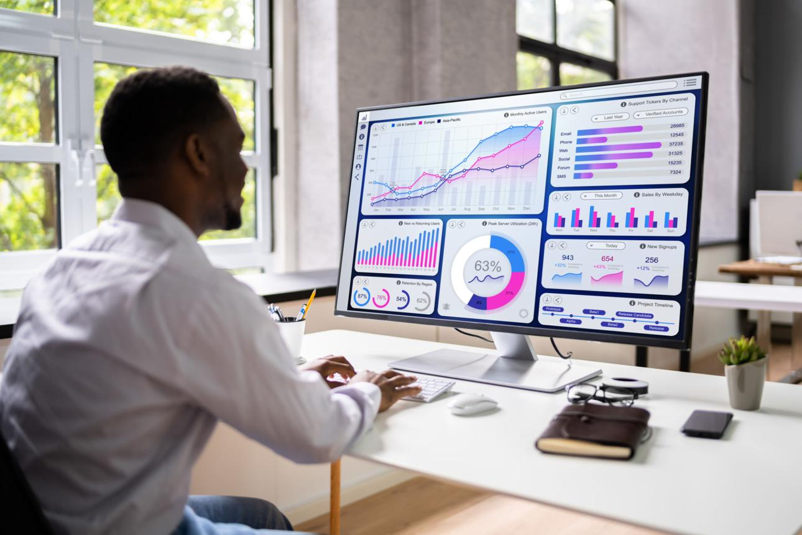
Applications of Computer Graphics

Slide 15
Applications of Computer Graphics
IMAGE PROCESSING
Image processing applies techniques to modify or interpret existing images or create new images.
To apply image processing methods, the image must be digitized first.
Medical applications also make extensive use of image processing techniques for picture enhancements, simulations of operations, etc.
Example: Adobe Photoshop, Snapchat filters

Slide 16
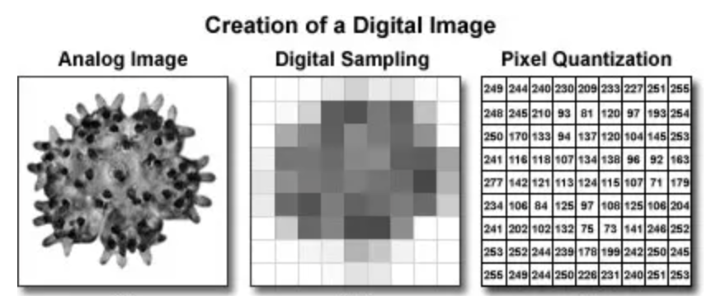

Slide 17
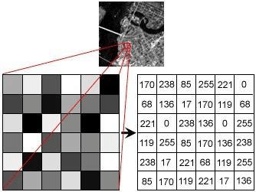
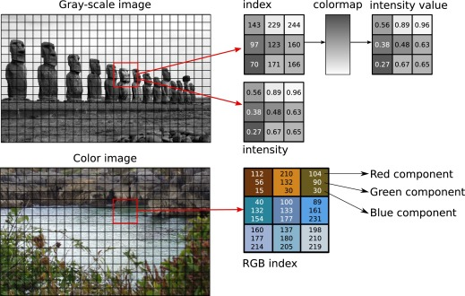

Slide 18
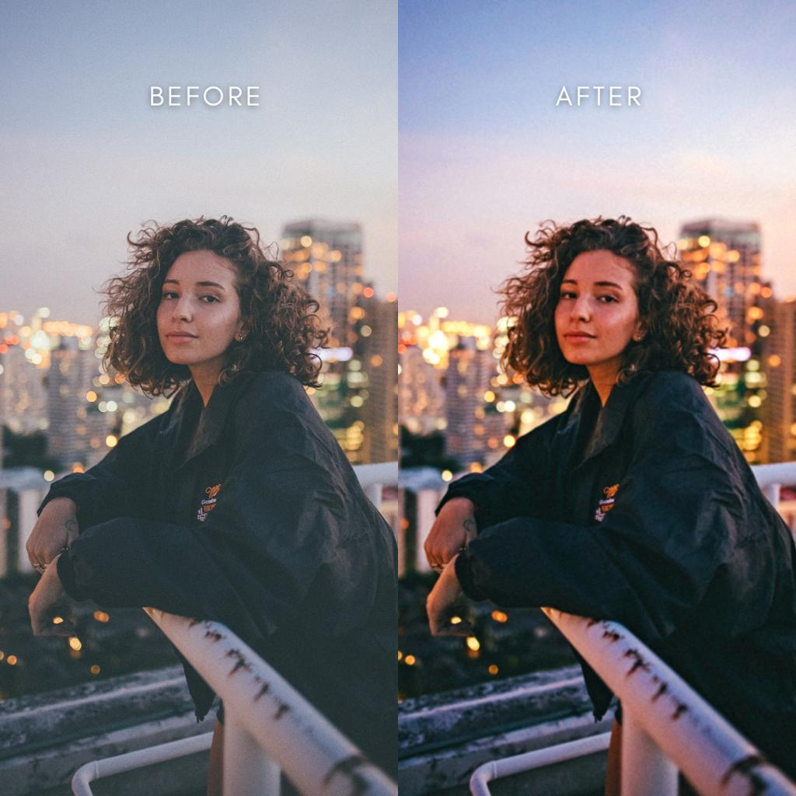
Applications of Computer Graphics

Slide 19
Applications of Computer Graphics
GRAPHICAL USER INTERFACE
Nowadays software packages provide graphics user interface (GUI) for the user to work easily.
A major component in GUI is a window.
Multiple windows can be opened at a time.
To activate any one of the window, the user needs just to check on that window.
Menus and icons are used for fast selection of processing operations.
Icons are used as shortcut to perform functions. The advantages of icons are which takes less screen space.
And some other interfaces like text box, buttons, and list are also used.
Example: Microsoft Windows, Android mobile apps

Slide 20
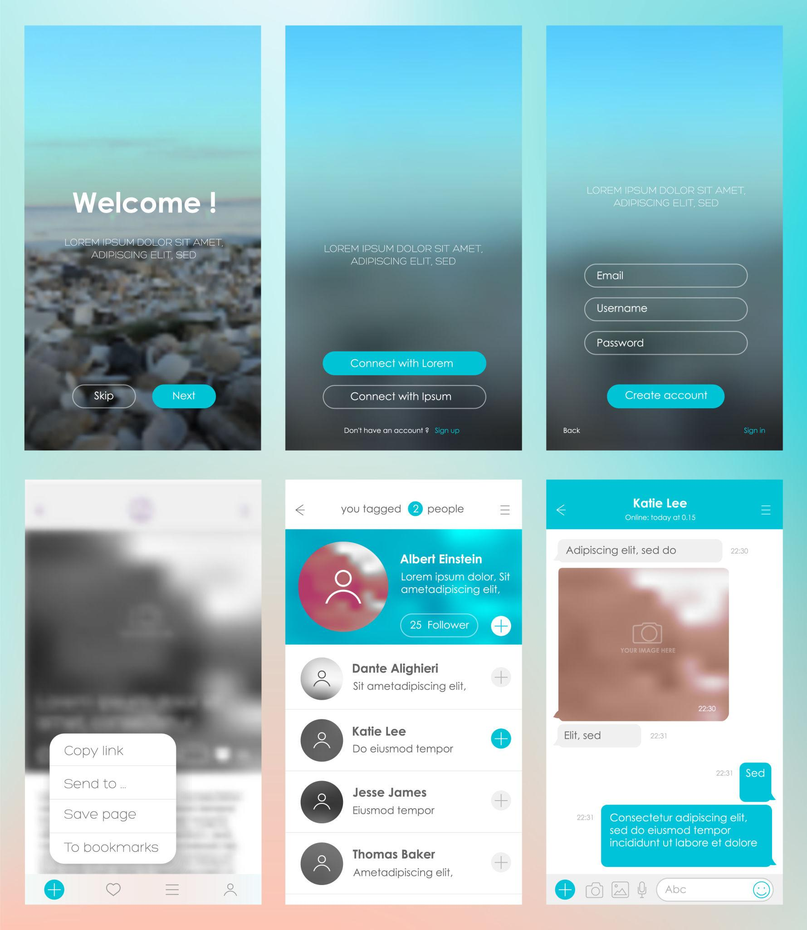
Applications of Computer Graphics

Slide 21


